Slide 1
Chat-bot for Taiwan-India Professional Expertise and Organization Cooperation Platform
資工三 林靖紳

Slide 2
Table of Contents
Project Goals
Project Requirements
Methods
Expected Results

Slide 3
Project Goals

Slide 4
Chat-Bot for Taiwan-India Talent matching
Project goal:
Design a text Chat-Bot on https://embedded.cs.ccu.edu.tw/center/#/
Provide a platform for Taiwanese and Indian job seekers to interact with recruiters.
Make it easier for both parties to find appropriate talents and occupations.
Users can explain their requirements for seeking projects in a dialogue with our Chat-Bot, such as their wanted project-type, salary, project duration, etc.

Slide 5
Project Requirements

Slide 6
Functional Requirements
Backend database
How to search results
According to the string labels returned from our Chat-Bot
String compare
How to reply promptly
Send request from frontend to backend by AJAX
Frontend Layout
User friendly

Slide 7
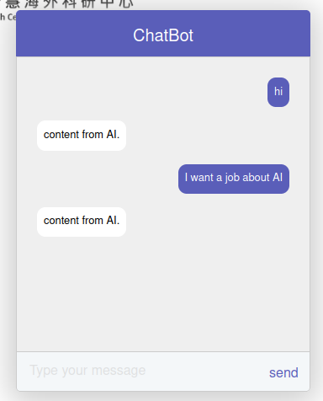
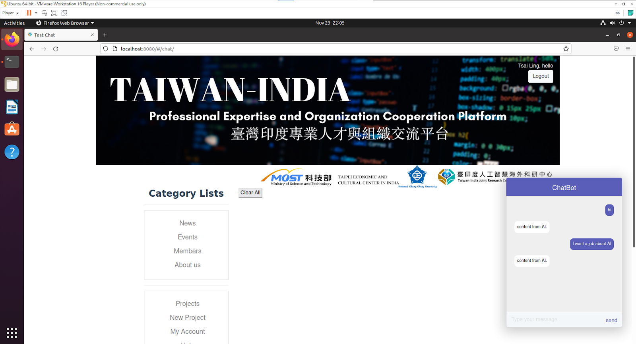

Slide 8
Functional Requirements
Chat-Bot
Question-and-answer
Intelligent response
How to distinguish different sentences’ meaning
How to extract keywords of labels from dialogue
How to improve Chat-Bot system

Slide 9
Method

Slide 10
Nature Language Processing
How to distinguish different sentences’ meaning
Nature Language Understanding
Find keywords
How to find keywords
Intent Classification
Slot filling

Slide 11
Nature Language Processing
How to distinguish different sentences’ meaning
Nature Language Understanding
Find keywords
How to find keywords
Intent Classification
Slot filling

Slide 12
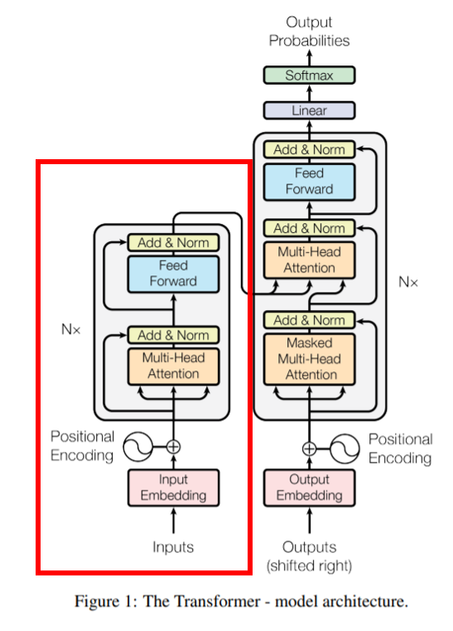
BERT
What is BERT
Bidirectional Encoder Representations from Transformers
Architecture
Multi-layer bidirectional Transformer encoder
Each Transformer encoder encapsulates two sub-layers:
self-attention layer
feed-forward layer.
Notes:
Bidirectional: BERT 的 self-attention layer 是雙向的，也就是訓練時會從 token（一個字符）的上、下文學習
上下文很重要是因為，同樣的字擺在不同的上下文位置，會有不同含意（contextual）

Slide 13
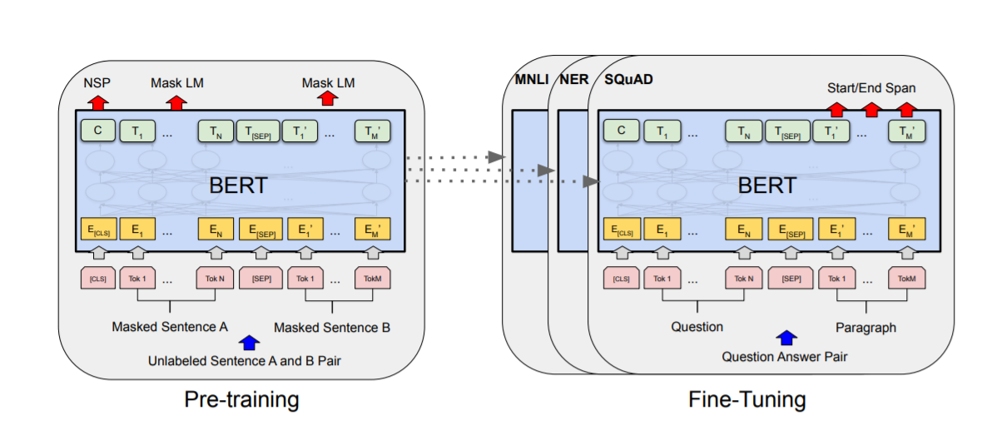
BERT
Concepts
A general architecture that can directly handle various NLP tasks
Train a BERT model (pre-training) that can be applied to multiple NLP tasks in advance
Then fine tune multiple downstream tasks on this basis.

Slide 14
BERT
Why BERT
It is pre-trained on unlabeled data extracted from BooksCorpus, which has 800M words, and from Wikipedia, which has 2,500M words.
Good performance in a wide range of NLP tasks (such as Question Answering (SQuAD v1.1)

Slide 15
Nature Language Processing
How to distinguish different sentences’ meaning
Nature Language Understanding
Find keywords
How to find keywords
Intent Classification
Slot filling

Slide 16
BERT
Intent Classification
focuses on predicting the intent of the query
Slot filling
extracts semantic concepts
After getting the intention, mark each word in the sentence
Format: BIO
B-X: This element belongs to type X, and located at the beginning of this fragment
I-X: This element belongs to type X, and located in the middle of this fragment
O: Other, this element doesn’t belong to any type

Slide 17
BERT
Input
BERT model expects a sequence of tokens (words) as an input.
Two special tokens:
[CLS]
The first token of every sequence, which stands for classification token.
[SEP]
Makes BERT know which token belongs to which sequence.
Important for a next sentence prediction task or question-answering task.
If we only have one sequence, then this token will be appended to the end of the sequence.
Notes:
Input Embedding 是 3 個部分的加總：Token, Segment, Position
Position: 文字在句中的位置
Segment: 文字屬於起頭句還是結尾句

Slide 18
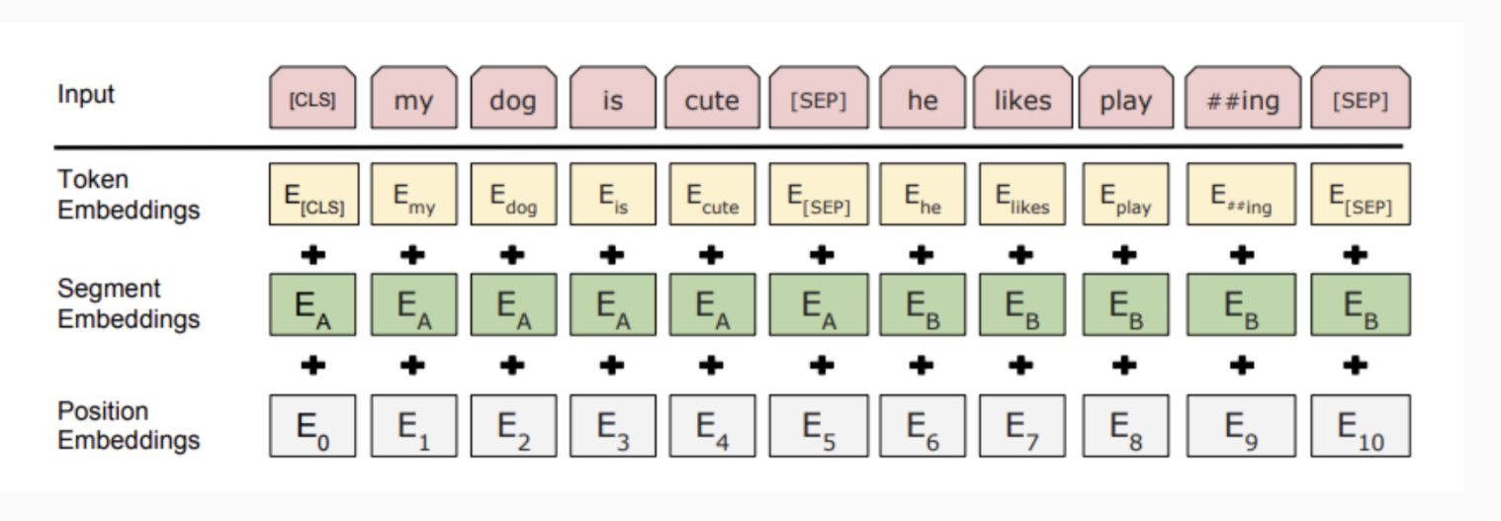

Slide 19
BERT
Output
An embedding vector of size 768 in each of the tokens
We can use these vectors as an input for different kinds of NLP applications
For a text classification task, we focus our attention on the embedding vector output from the special [CLS] token.
(Example on next page)

Slide 20
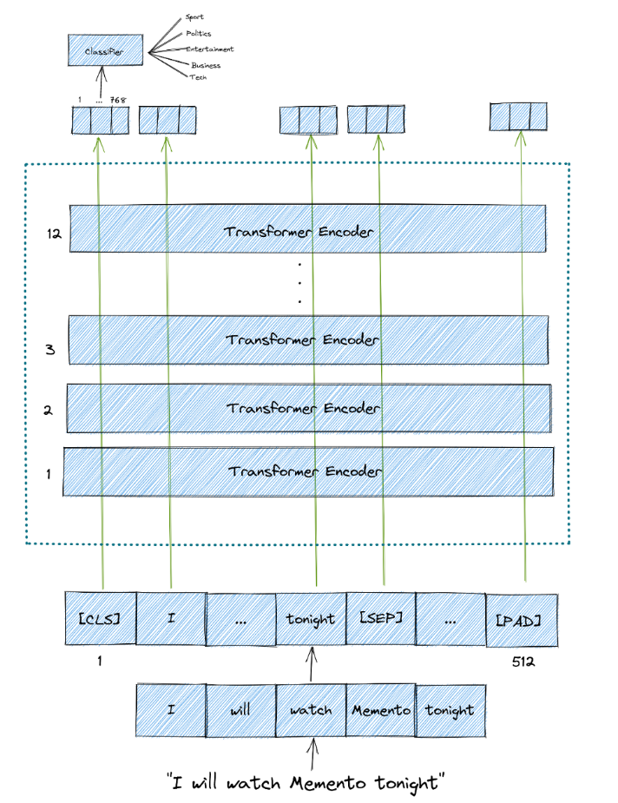

Slide 21
Expected Results

Slide 22
